Slide 1
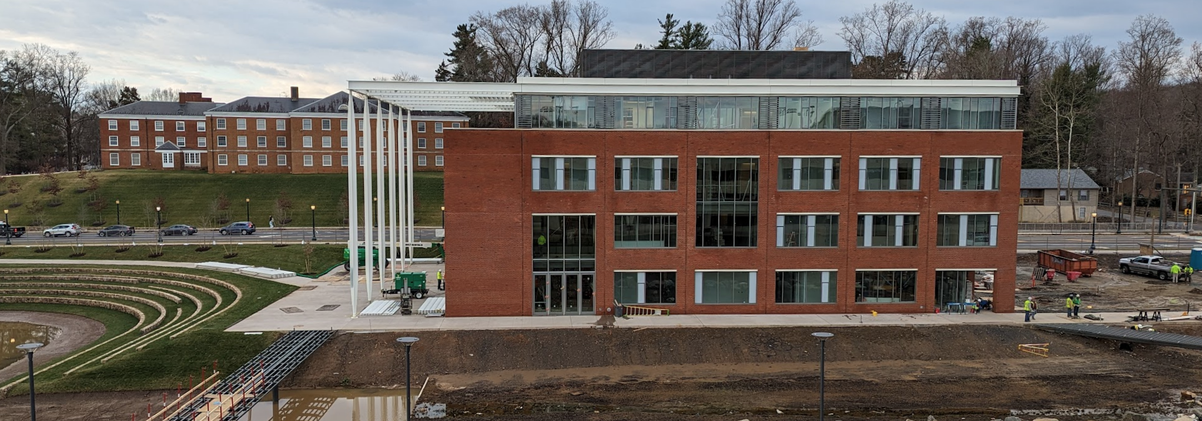
The Future of Data Science Education
Peter Alonzi, Brian Wright, Ali Rivera; UVA School of Data Science
SEDSI 53rd Annual Meeting; Charleston, SC
2024-02-21

Slide 2
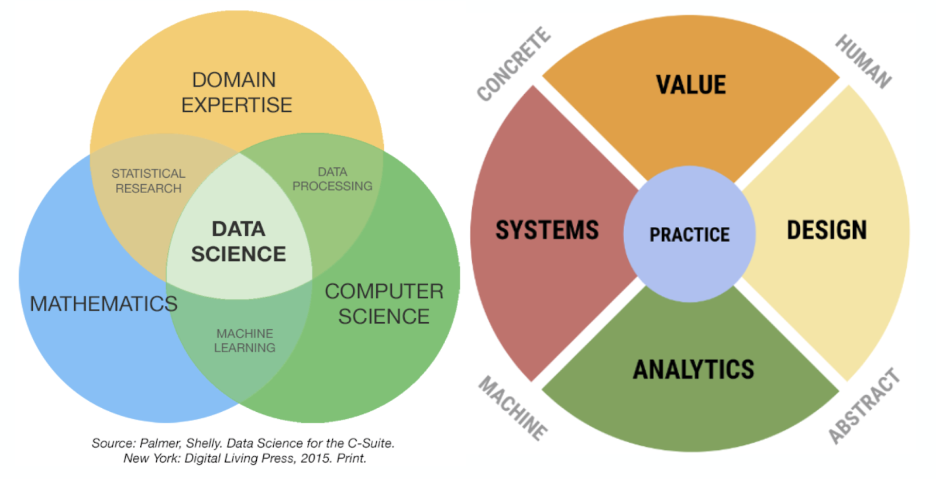
Data Science Generation 0
A combination of three domains
Math
CS
Whatever you do
For a full description of the history see Alvarado: [2311.03292] Data Science from 1963 to 2012 (arxiv.org)

Slide 3
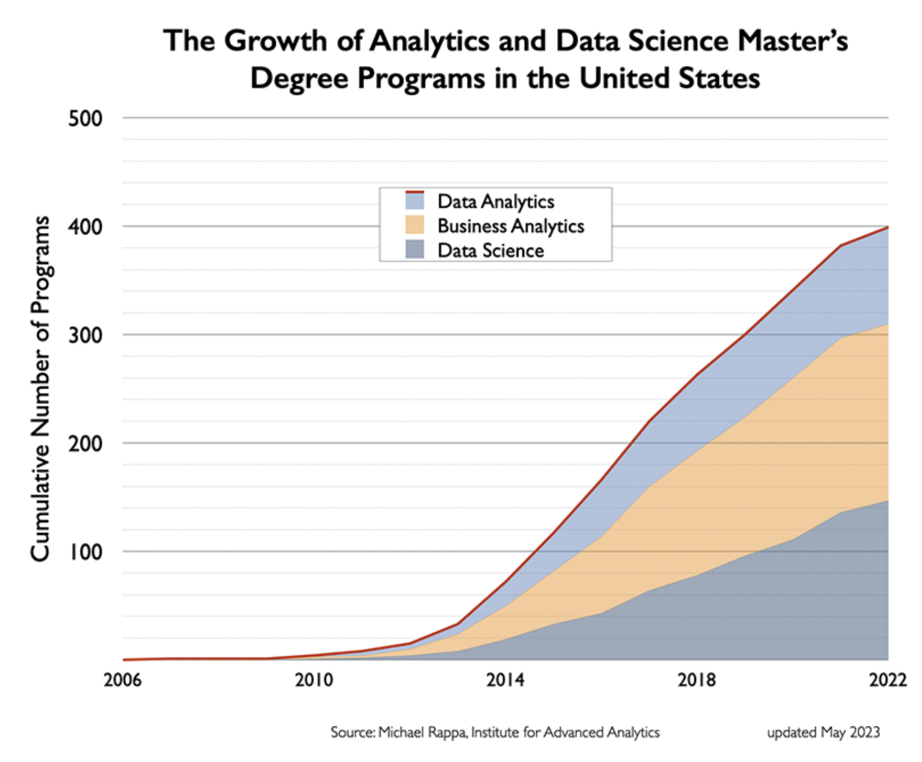

Slide 4
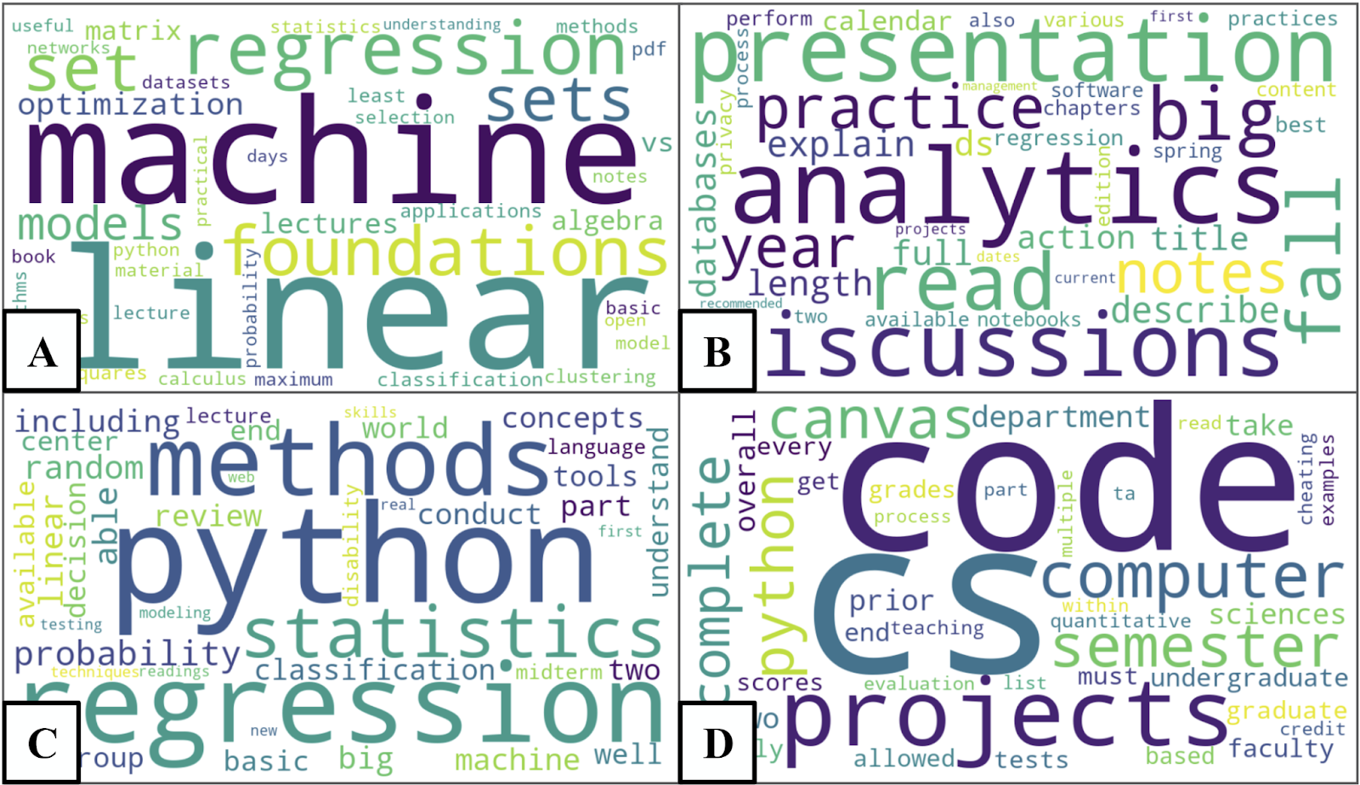

Slide 5
The core tension
Data sets are made by humans …
… but …
… this model leaves them out.

Slide 6
Gen 0
Gen 1
For a full description of the model see Alvarado: [2311.07631] The 4+1 Model of Data Science (arxiv.org)

Slide 7
Fundamental questions of Data Science
How do I make a data set that faithfully represents the world?
How do I evaluate the quality of a data set?
Should I make/use this data set?
Whom can this data set harm?
What scale is necessary?
Which tool will best extract the information from the data set?

Slide 8
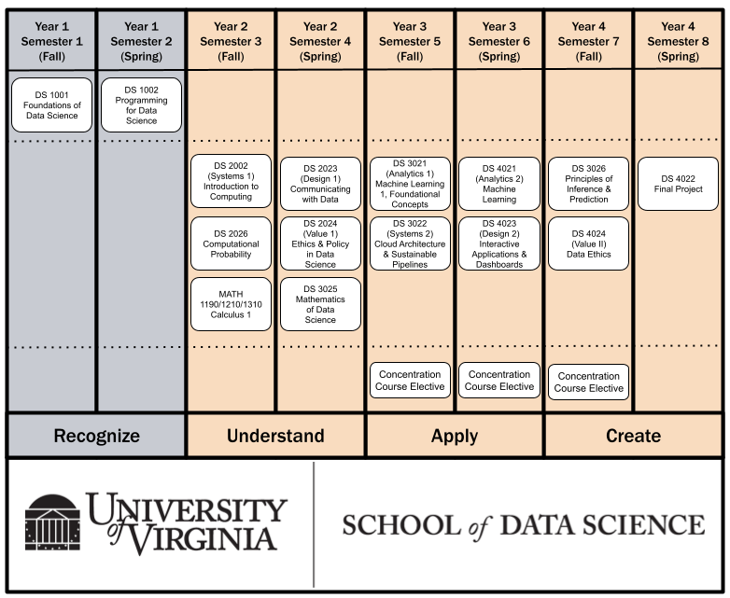
Bachelor of Science in Data Science (BSDS)
Approved by the State Council of Higher Education for Virginia (Sep 2023)
Students apply for major after their first year at UVA
Curriculum Highlights
40 credit core
9 credit concentration
Area of Data Science
Partnered with other UVA Schools
First class will graduate in 2027!

Slide 9
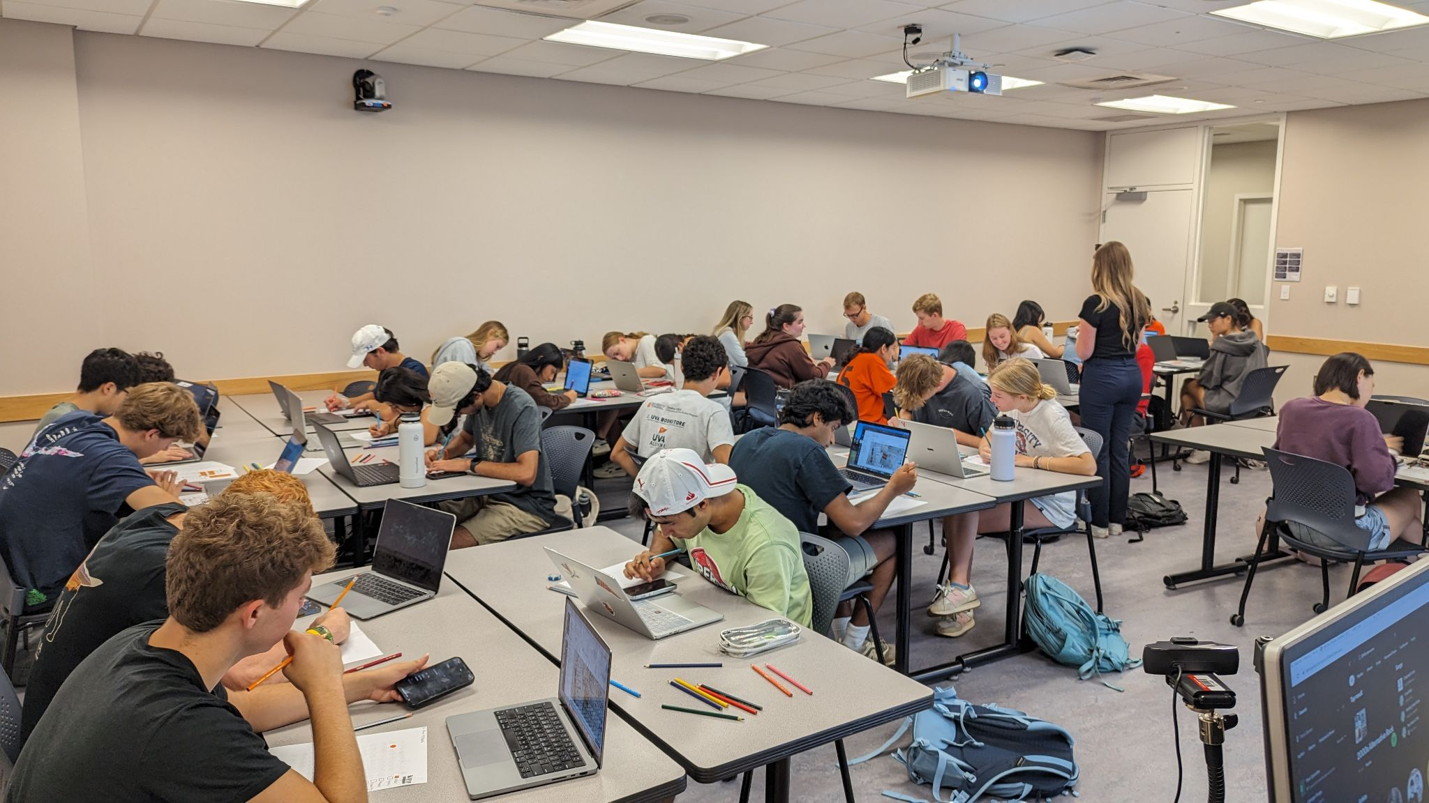
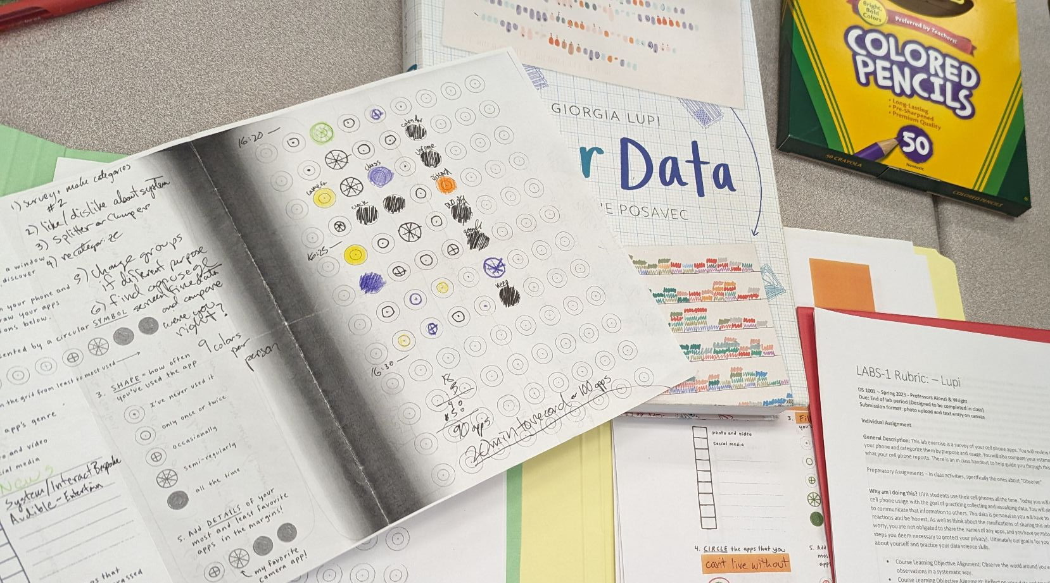
It all starts in DS 1001: Foundations of Data Science
Syllabus: github.com/uvads/ds1001
Survey of the 4 areas of Data Science
Active Learning
Specifications Grading

